Slide 1
最新_{C}程式語言
蔡明志 編著

Slide 2
選擇敘述
5
5.1 if敘述與關係運算子
5.2 if.....else敘述
5.3 巢狀if敘述
5.4 真值與假值
5.5 邏輯運算子
5.6 條件運算子
5.7 else if多重選擇
5.8 switch敘述
5.9 goto敘述

Slide 3
if敘述與關係運算子
5.1
if敘述又稱為“分支敘述 (branching statement)”
if後面至少有個小括號，小括號裡面乃為一般的運算式，譬如(a>b)(a大於b)或是(x == y)(x等於y)等等。

Slide 4
/* ch5 ifl.c */
#include <stdio.h>
#include <stdlib.h>
int main()
{
int num;
printf("Please input a number between 1 to 100 : ");
scanf("%d", &num);
if (num < 50)
printf("The number is less than 50 !\n");
if (num == 50)
printf("The number is equal to 50 !\n");
if (num > 50)
printf("The number is greater to 50 !\n");
system("PAUSE");
return 0;
}

Slide 5
執行的結果：
Please input a number between 1 to 100 : 14
The number is less than 50 !
Please input a number between 1 to 100 : 50
The number is equal to 50 !
Please input a number between 1 to 100 : 62
The number is greater to 50 !

Slide 6
關係運算子便可組成關係運算式。C語言共提供六種關係運算子，它們都是二元運算子
表 5-1 關係運算子
運算子 | 意義
< | 小於
<= | 小於等於
= = | 等於
>= | 大於等於
> | 大於
!= | 不等於

Slide 7
/* ch5 if2.c */
#include <stdio.h>
#include <stdlib.h>
int main()
{
int num;
int flag = 0;
num = 14;
if (num < 50){
flag++;
printf("Message 1...\n");
}
if (num > 50)
flag++;
printf("Message 2...\n");
if (num == 50)
flag++;
printf("Message 3...\n");
printf("\nflag is %d\n",flag);
system("PAUSE");
return 0;
}

Slide 8
程式輸出如下：
根據結果顯示，我們可畫出下列流程：
Message 1...
Message 2...
Message 3...
flag is 1

Slide 9
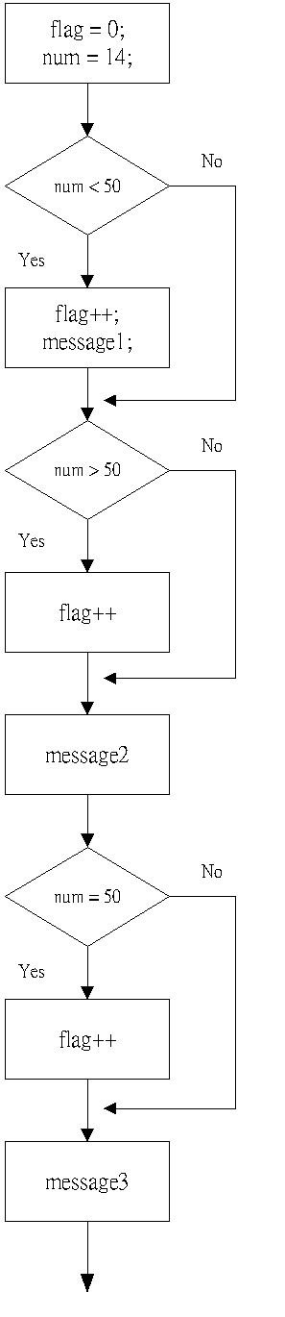

Slide 10
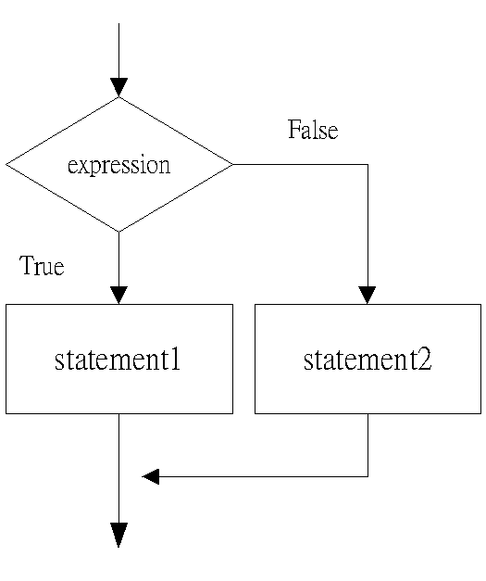
if.....else敘述
5.2

Slide 11
/* ch5 if_else.c */
#include <stdio.h>
#include <stdlib.h>
int main()
{
char ch;
printf("Play again ? [Y/y] ");
scanf("%c", &ch);
if (ch = = 'y')
ch = 'Y';
if (ch = = 'Y'){
printf("Play again !\n");
printf("I like this game...\n");
}
else{
printf("Exit the game !\n");
printf("I don't like this game.\n");
}
printf("Test over !\n");
system("PAUSE");
return 0;
}

Slide 12
/* ch5 nest1.c */
#include <stdio.h>
#include <stdlib.h>
int main()
{
int num;
printf("Please input a number between 1 to 100 : ");
scanf("%d", &num);
if(num >= 1)
if(num <= 100)
printf("Valid number %d\n", num);
else
printf("Invalid number %d.\n", num);
printf("Bye Bye !\n");
system("PAUSE");
return 0;
}

Slide 13
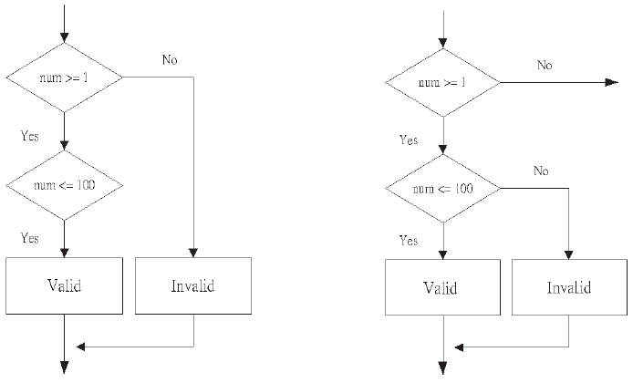
else屬於第一個if
else屬於第二個if

Slide 14
從執行結果來推導：
Please input a number between 1 to 100 : 5060
Invalid number 5060
Bye Bye !
Please input a number between 1 to 100 : 14
Valid number 14
Bye Bye !
Please input a number between 1 to 100 : -62
Bye Bye !

Slide 15
/* ch5 nest2.c */
#include <stdio.h>
#include <stdlib.h>
int main()
{
int num;
printf("Please input a number between 1 to 100 : ");
scanf("%d", &num);
if (num >= 1){
if (num <= 100)
printf("Valid number %d\n", num);
else
printf("Invalid number %d\n", num);
}
else
printf("Invalid number %d\n", num);
printf("Bye Bye !\n");
system("PAUSE");
return 0;
}

Slide 16
執行範例為：
Please input a number between 1 to 100 : 123
Invalid number 123
Bye Bye !
Please input a number between 1 to 100 : 100
Valid number 100
Bye Bye !

Slide 17
/* ch5 t_f1.c */
#include <stdio.h>
#include <stdlib.h>
int main()
{
printf(" 10 > 100 ===> %d\n",10 > 100);
printf(" 10 < 100 ===> %d\n",10 < 100);
printf(" 10 = = 100 ===> %d\n",10 = = 100);
printf(" 10 != 100 ===> %d\n",10 != 100);
system("PAUSE");
return 0;
}

Slide 18
由輸出結果應能得出真假值的確實數值：
10 > 100 ===> 0
10 < 100 ===> 1
10 = = 100 ===> 0
10 != 100 ===> 1

Slide 19
/* ch5 t_f2.c */
#include <stdio.h>
#include <stdlib.h>
int main()
{
if (1)
printf("1 is TRUE.\n");
else
printf("1 is FALSE.\n");
if (0)
printf("0 is TRUE.\n");
else
printf("0 is FALSE.\n");
if (14)
printf("14 is TRUE.\n");
else
printf("14 is FALSE.\n");
if (-62)
printf("-62 is TRUE.\n");
else
printf("-62 is FALSE.\n");
system("PAUSE");
return 0;
}

Slide 20
輸出結果
1 is TRUE.
0 is FALSE.
14 is TRUE.
-62 is TRUE.

Slide 21
邏輯運算子
5.5
表5-2 邏輯運算子
運算子 | 意義
! | 非(NOT)
&& | 且(AND)
|| | 或(OR)

Slide 22
/* ch5 logical1.c */
#include <stdio.h>
#include <stdlib.h>
int main()
{
printf("NOT (3 > 5) ===> %d\n", !(3 > 5));
printf("(3 > 5) OR (10 > 6) ===> %d\n", (3 > 5) || (10 > 6));
printf("(3 > 5) AND (10 > 6) ===> %d\n", (3 > 5) && (10 > 6));
printf("(3 > 5) AND (10 > 6) OR 10 ===> %d\n", (3 > 5) && (10 > 6) || 10);
printf("(5 > 3) OR (10 > 6) AND 0 ===> %d\n", (5 > 3) || (10 > 6) && 0);
system("PAUSE");
return 0;
}

Slide 23
輸出的結果是這樣的：
NOT (3 > 5) ===> 1
(3 > 5) OR (10 > 6) ===> 1
(3 > 5) AND (10 > 6) ===> 0
(3 > 5) AND (10 > 6) OR 10 ===> 1
(5 > 3) OR (10 > 6) AND 0 ===> 1

Slide 24
前面三條式子沒有問題。最後兩個運算式則要考慮優先順序高低的影響：
(3 > 5) AND (10 > 6) OR 10
=>((3 > 5) AND (10 > 6 )) OR 10
=>(False AND True) OR True
=> False OR True
=> True
(5 > 3) OR (10 > 6) AND 0
=>(5 > 3) OR ((10 > 6) AND 0)
=>True OR (True AND False)
=>True OR False
=>True

Slide 25
/* ch5 logical2.c */
#include <stdio.h>
#include <stdlib.h>
int main()
{
int num;
printf("Please input a number between 1 to 100 : ");
scanf("%d", &num);
if ((num >= 1) && (num <= 100))
printf("Valid number %d !\n", num);
else
printf("Invalid number %d.\n", num);
printf("Bye Bye !\n");
system("PAUSE");
return 0;
}

Slide 26
執行結果
Please input a number between 1 to 100 : 114
Invalid number 114.
Bye Bye !
Please input a number between 1 to 100 : 1
Valid number 1 !
Bye Bye !
Please input a number between 1 to 100 : -5060
Invalid number -5060.
Bye Bye !

Slide 27
/* ch5 if_else.c */
#include <stdio.h>
#include <stdlib.h>
int main()
{
char ch;
printf("Play again ? [Y/y] ");
scanf("%c", &ch);
if ((ch = = 'y') || (ch = = 'Y')) {
printf("Play again !\n")
printf("I like this game...\n");
}
else{
printf("Exit the game !\n");
printf("I do'nt like this game.\n");
}
printf("Test over !\n");
system("PAUSE");
return 0;
}

Slide 28
執行結果如下：
Play again ? [Y/y] y
Play again !
I like this game...
Test over !

Slide 29
/* ch5 logical3.c */
#include <stdio.h>
#include <stdlib.h>
int main()
{
int num;
printf("Input a number : ");
scanf("%d", &num);
if((num != 0) && ! (24 % num))
printf("Number %d is a factor of 24.\n", num);
else
printf("Number %d is not a factor of 24.\n", num);
system("PAUSE");
return 0;
}

Slide 30
程式logical3.c的執行結果如下：
Input a number : 10
Number 10 is not a factor of 24.
Input a number : 0
Number 0 is not a factor of 24.
Input a number : 6
Number 6 is a factor of 24.

Slide 31
/* ch5 cond.c */
#include <stdio.h>
#include <stdlib.h>
int main()
{
int x,y;
int abs, max;
int year;
printf("\nInput x : ");
scanf("%d", &x);
abs = (x >= 0) ? x : -x;
printf("|x| = %d\n", abs);

Slide 32
scanf("%d", &y);
abs = (y >= 0) ? y : -y;
printf("|y| = %d\n", abs);
max = (x > y) ? x : y;
printf("\nMaximum value of %d and %d is %d.\n", x, y, max);
printf("\nHow old are you ? ");
scanf("%d", &year);
printf(" You are %d year%sold.\n",year,(year > 1) ? "s " : " ");
system("PAUSE");
return 0;
}

Slide 33
執行結果如下：
Input x : -14
|x| = 14
Input y : -62
|y| = 62
Maximum value of -14 and -62 is -14.
How old are you ? 23
You are 23 years old.

Slide 34
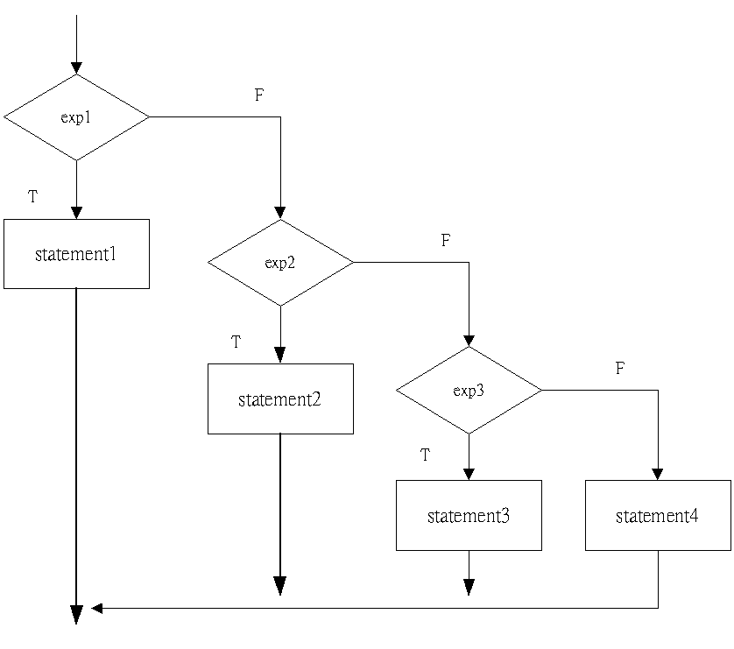

Slide 35
/* ch5 else_if.c */
#include <stdio.h>
#include <stdlib.h>
int main()
{
char grade;
int score;
printf("What's your score ? ");
scanf("%d", &score);
if(score > 100 || score < 0)
printf("It's impossible !\n");
else if (score >= 90)
grade = 'A';
else if (score >= 80)
grade = 'B';
else if (score >= 70)
grade = 'C';
else if (score >= 60)
grade = 'D';
else
printf("You are down !\n");
if( score >= 60 && score <=100)
printf("Score %d ===> %c\n", score, grade);
system("PAUSE");
return 0;
}

Slide 36
執行情形
What's your score ? 114
It's impossible !
What's your score ? 91
Score 91 ===> A
What's your score ? 14
You are down !

Slide 37
/* ch5 switch1.c */
#include <stdio.h>
#include <stdlib.h>
int main()
{
char grade;
printf("What's your score grade (A-E) ? ");
scanf("%c", &grade);
if ((grade >= 'A') && (grade <= 'Z'))
grade = 'a' + (grade - 'A');

Slide 38
switch (grade){
case 'a' : printf("Score 90 to 100.\n");
break;
case 'b' : printf("Score 80 to 89.\n");
break;
case 'c' : printf("Score 70 to 79.\n");
break;
case 'd' : printf("Score 60 to 69.\n");
break;
case 'e' : printf("Score under 60.\n");
break;
default : printf("Wrong grade !\n");
}
system("PAUSE");
return 0;
}

Slide 39
程式中的測試運算式為grade，它是char型態的變數，我們還要注意到，標記採用的形式均為字元常數，最後也有default:標記。
執行結果：
What's your score grade (A-E) ? A
Score 90 to 100.
What's your score grade (A-E) ? d
Score 60 to 69.
What's your score grade (A-E) ? e
Score under 60.
What's your score grade (A-E) ? y
Wrong grade !

Slide 40
/* ch5 switch2.c */
#include <stdio.h>
#include <stdlib.h>
int main()
{
char grade;
printf("What's your score grade (A-E) ? ");
scanf("%c", &grade);
switch (grade){
case 'A' :
case 'a' : printf("Score 90 to 100.\n");
case 'B' :
case 'b' : printf("Score 80 to 89.\n");
case 'C' :
case 'c' : printf("Score 70 to 79.\n");
case 'D' :
case 'd' : printf("Score 60 to 69.\n");
case 'E' :
case 'e' : printf("Score under 60.\n");
default : printf("Wrong grade !\n");
}
system("PAUSE");
return 0;
}

Slide 41
What's your score grade (A-E) ? B
Score 80 to 89.
Score 70 to 79.
Score 60 to 69.
Score under 60.
Wrong grade !
What's your score grade (A-E) ? d
Score 60 to 69.
Score under 60.
Wrong grade !

Slide 42
/* ch5 goto1.c */
#include <stdio.h>
#include <stdlib.h>
#include <conio.h>
int main()
{
int left, right;
int mid;
char echo;
printf("Choose a number (1-100) !\n");
printf(" And I will guess it.\n");
left = 1;
right = 100;

Slide 43
loop :
if (left > right){
printf("You cheat me !\n");
goto quit;
}
mid = (left + right) / 2;
again :
printf("\nYour number is %d.\n", mid);
printf("match(m), greater(g), or smaller(s) ? ");
scanf("%c", &echo);
switch (echo){
case 'M' :
case 'm' : printf("I just know it !\n");
goto quit;
case 'G' :
case 'g' : right = mid - 1;
goto loop;
case 'S' :
case 's' : left = mid + 1;
goto loop;
default :
goto again;
}
quit :
getch();
system("PAUSE");
return 0;
}

Slide 44
程式中以goto敘述做出許多控制效果，像是迴圈(loop)、跳離(quit)、中斷(break)等等，事實上這些效果都可經由C語言的控制敘述來完成；譬如上一節介紹的break敘述，還有下一章將要討論的while與for等迴圈結構。

Slide 45
Choose a number (1-100) !
And I will guess it.
Your number is 50.
match(m), greater(g), or smaller(s) ? s
Your number is 75.
match(m), greater(g), or smaller(s) ?
Your number is 75.
match(m), greater(g), or smaller(s) ? s
Your number is 88.
match(m), greater(g), or smaller(s) ?
Your number is 88.
match(m), greater(g), or smaller(s) ? g
Your number is 81.
match(m), greater(g), or smaller(s) ?
Your number is 81.
match(m), greater(g), or smaller(s) ? s

Slide 46
Your number is 84.
match(m), greater(g), or smaller(s) ?
Your number is 84.
match(m), greater(g), or smaller(s) ? s
Your number is 86.
match(m), greater(g), or smaller(s) ?
Your number is 86.
match(m), greater(g), or smaller(s) ? g
Your number is 85.
match(m), greater(g), or smaller(s) ?
Your number is 85.
match(m), greater(g), or smaller(s) ? m
I just know it !

Slide 47
/* ch5 goto2.c */
#include <stdio.h>
#include <stdlib.h>
#include <conio.h>
int main()
{
int left = 1, right = 100;
int mid;
char echo;
printf("Choose a number (1-100) !\n");
printf(" And I will guess it.\n");
loop :
if (left > right){
printf("\nYou cheat me !\n");
goto quit;
}
mid = (left +right) / 2;
again :

Slide 48
printf("\n\nYour number is %d.\n", mid);
printf("Match, Greater, or Smaller ? ");
echo = getche();
switch (echo){
case 'M' :
case 'm' : printf("\nI just know it !\n");
goto quit;
case 'G' :
case 'g' : right = mid - 1;
goto loop;
case 'S' :
case 's' : left = mid + 1;
goto loop;
default : goto again;
}
quit :
getche();
system("PAUSE");
return 0;
}

Slide 49
執行結果
Choose a number (1-100) !
And I will guess it.
Your number is 50.
Match, Greater, or Smaller ? s
Your number is 75.
Match, Greater, or Smaller ? s
Your number is 88.
Match, Greater, or Smaller ? g
Your number is 81.
Match, Greater, or Smaller ? s
Your number is 84.
Match, Greater, or Smaller ? s
Your number is 86.
Match, Greater, or Smaller ? g
Your number is 85.
Match, Greater, or Smaller ? g
You cheat me !

Slide 50
/* ch5 goto3.c */
#include <stdio.h>
#include <stdlib.h>
int main()
{
int left, right;
int mid;
char echo;
printf("Choose a number (1-100) !\n");
printf(" And I will guess it.\n");
left = 1;
right = 100;
while (left <= right) {

Slide 51
mid = (left + right) / 2;
printf("\nYour number is %d.\n", mid);
printf("Match, Greater, or Smaller ? ");
scanf("%c",&echo);
while(getchar() != '\n')
;
if(echo == 'M' || echo == 'm') {
printf("I just know it !\n");
break;
}
switch (echo){
case 'G' :
case 'g' : right = mid - 1;
break;
case 'S' :
case 's' : left = mid + 1;
break;
}
}
if(echo != 'M' && echo != 'm')

Slide 52
執行結果如下：
Choose a number (1-100) !
And I will guess it.
Your number is 50.
Match, Greater, or Smaller ? s
Your number is 75.
Match, Greater, or Smaller ? s
Your number is 88.
Match,Greater, or Smaller ? g
Your number is 81.
Match, Greater, or Smaller ? s
Your number is 84.
Match,Greater, or Smaller ? s
Your number is 86.
Match, Greater, or Smaller ? g
Your number is 85.
Match, Greater, or Smaller ? m
I just know it !

